Slide 1
Lecture week # 1
MECHANICAL ENGINEERING DEPARTMENT
HITEC UNIVERSITY
Text Book: Applied Thermodynamics-I
by
T.D.Eastop A.McCon,key
By Syeda Zeenat Shirazi

Slide 2
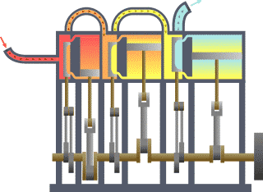

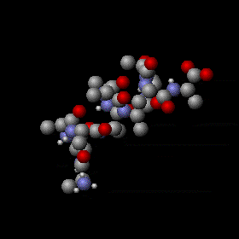
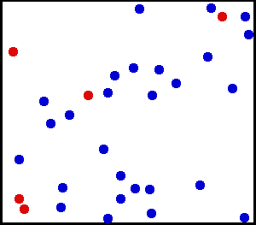
Thermodynamics
Thermos
Dynamics
Heat
power

Slide 3
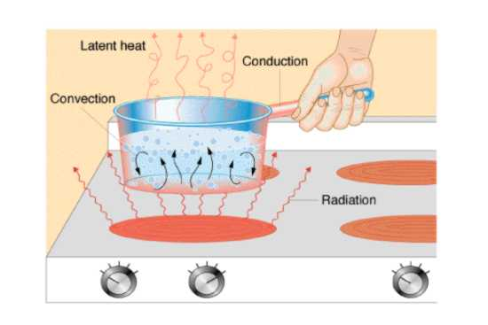
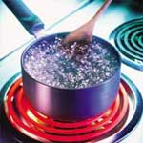
Heat Transfer
Heat is the form of energy that can be transfer from one system to another as a result of temperature difference.

Slide 4
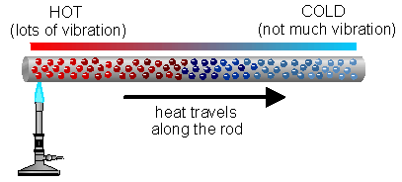
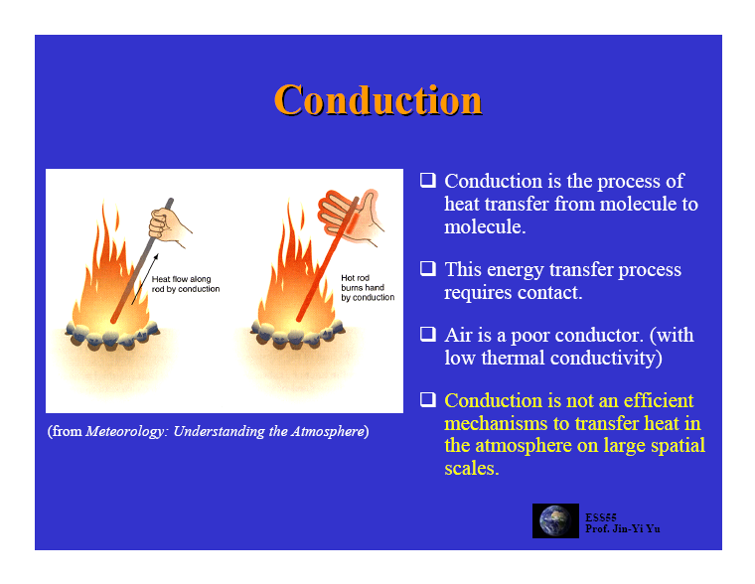
Thermal Conduction

Slide 5
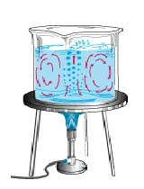
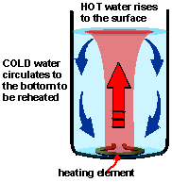
Thermal Convection

Slide 6
Radiation
Heat transfer by electromagnetic waves
Does not need a material medium
Black body: perfect absorber → perfect emitter (at all wavelengths)

Slide 7
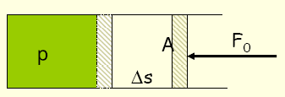
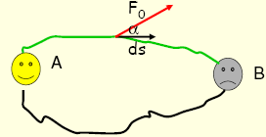
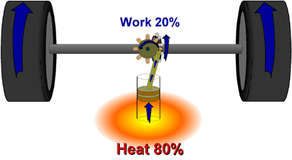
HEAT & WORK
Q & W
Intrinsic Energy
W = F . S
Work is organized form of energy
Energy can transfer in two forms heat & work.
Total change of system energy is their sum.

Slide 8
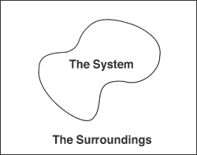
Thermodynamic System
Boundary thickness of the system assume to be zero.
Moving boundary
CV
Real Boundary
Fixed Boundary
Imaginary Boundary
CV

Slide 9
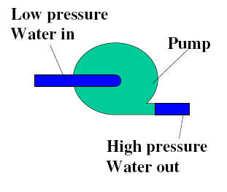

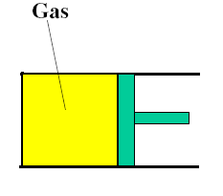
OPEN SYSTEM: can exchange both matter and energy with the surroundings (e.g. open reaction flask, rocket engine)
CLOSED SYSTEM: can exchange only energy with the surroundings (matter remains fixed) e.g. a sealed reaction flask
ISOLATED SYSTEM: can exchange neither energy nor matter with its surroundings (e.g. a thermos flask)

Slide 10
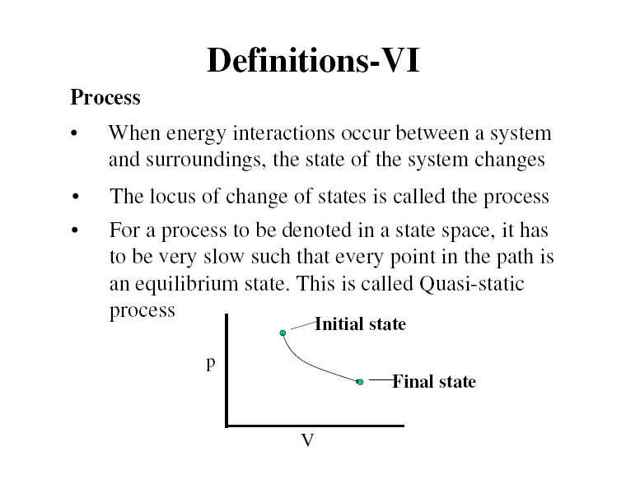
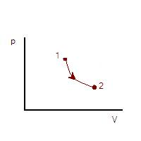
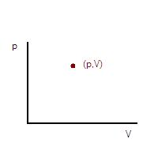
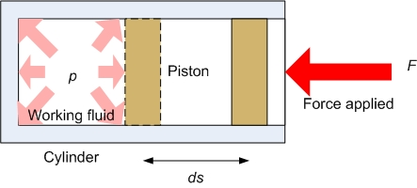
State of Working Fluid
Consider a System not undergoing any change
Properties of thermodynamics

Slide 11
The State Postulate
Compressible system
T = f (P)
During phase change processes
Nitrogen
V= 12m³
m=3kg
ρ= 0.25kg/m³
v= 1/ ρ=4m³/kg
T = 25 C⁰
v = 0.9 m³ /kg
External Forces
Intensive Property
Extensive property

Slide 12
Equilibrium
20 c⁰ 23 c⁰
30 c⁰
35c⁰ 40 c⁰
40 c⁰
Mechanical Equilibrium
32 c⁰ 32 c⁰
32 c⁰
32c⁰ 32 c⁰
32 c⁰
Thermal Equilibrium
Hot
Coffee
70c⁰
Before thermal equilibrium
Cool environment 20c⁰
Heat Flow in the direction
of decreasing temperature
After thermal equilibrium
Phase Equilibrium
Chemical Equilibrium

Slide 13

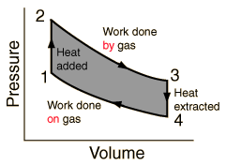
Processes & Cycle
Quasi-static
or
Quasi-equilibrium process
Stat 2
Process Path
Stat 1
Slow compression
Fast Compression

Slide 14
Temperature
Copper
150c⁰
Zeroth Law
1993
Copper
60c⁰
Iron
60c⁰
Body C
Two bodies reaching thermal equilibrium after brought in contact in an isolated enclosure.
Iron
20c⁰
Isolated system
Body A
Body B

Slide 15
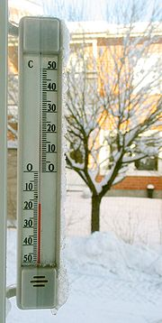
Graph of Temperature Against Volume
Mercury thermometer
Gas thermometer
V o l u m e
Vol. at ice point
temperature
Vol. at steam point
Define it as the absolute scale
of temperature
-273 C⁰

Slide 16
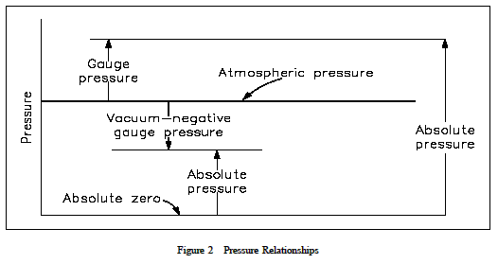
Pressure
1kgf/cm² =9.8 x 10⁴ N/m²
P = F/A
1 N/m² = 1 pa
1bar = 10⁵ N/m²
Pressure Gauge
P_{absoult} = P_{gauge} + P_{atmosphere}

Slide 17
Reversibility
P
P
1
1
Irreversible Processes
Reversible Processes
2
2
V
V
Note : Practically reversible processes does not exist

Slide 18
Reversible Work
(p + dp) A
Piston Pressure
P
Piston
2
Fluid in cylinder undergoing a compression
p
1
Work done in a compression process
V
dv

Slide 19
Example # 1
Unit mass of the fluid at a pressure of 3 bar and with specific volume of 0.18 m³/kg, contain in a cylinder behind a piston expands reversibly to a pressure of 0.6 bar according to a law p=c/v² , where c is a constant. Calculate the work done during processes.
0.18 m³ /kg
3 bar
Piston
Expansion
0.6 bar
Piston

Slide 20
Example # 2
Unit mass of certain fluid contain in at an initial pressure of 20 bar. The fluid is allowed to expand reversibly behind a piston according to the law pV²=c until volume is double. The fluid is then cooled reversibly at constant pressure until piston regains its original position; heat is then supplied reversibly with piston firmly locked in position until pressure rises to the original value of 20bar. Calculate the net work done of the fluid, for an initial volume of 0.05m³.
Piston
0.05 m³ 20bar
Expansion
0.1 m³, P₂
0.05 m³
P₃

Slide 21
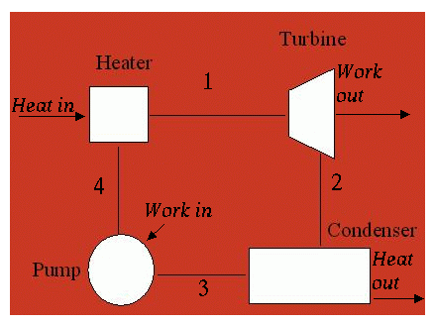
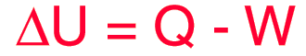
First Law of Thermodynamics
LAW OF CONSERVATION
OF ENERGY
∑ Q + ∑W = 0
Non-Flow Energy
Equation
Specific Internal Energy

Slide 22
Steady Flow Energy Equation
Specific Enthalpy
Inlet
Q
Z1
W
Outlet
Boundary
Z2
Datum line

